Slide 1
Digital Image Forgery Detection
Ales Zita

Slide 2
Publication
Digital Image Forgery Detection Based on Lens and Sensor Aberration
Authors : Ido Yerushalmy , Hagit Hel-Or
Dept. of Computer Science, University of Haifa, Israel
Published in International Journal of Computer Vision
DOI 10.1007/s11263-010-0403-1
Springer Science + Business Media LLC 2010

Slide 3
Introduction
Digital image age
Methods of forgery detection
Intelligent Reasoning
Additional Data Embedding
Statistical
Detection Without Additional Data

Slide 4
Intelligent reasoning

Slide 5
Methods
Intelligent reasoning
Semantics, geometry, scene lighting, etc..
Additional data embedding
Watermarking
Statistics based methods
Training sets, classification techniques (SVM)
Detection Without Additional Data
Brute force, JPEG based, CFA based, Chromatic Aberration based

Slide 6
Detection w/o additional data
Brute force – detecting duplicates in the feature space (Fridrich at al. 2003)
Colour interpolation algorithm scheme discrepancies (Wolfgang and Delp 1996)
Repetitive spatial pattern in JPEG compressed images (Wang and Farid 2006)
Lens Chromatic Aberration based (Johnson and Farid 2006)

Slide 7
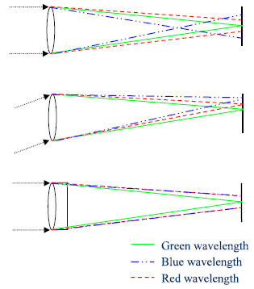
Lens Chromatic Aberrations
Variety of aberration of optical systems
Chromatic Aberration – Snell’s law of refraction
Spatial Blur
Geometric Distortion
Lens Chromatic Aberrations
Axial Chromatic Aberration
Lateral Chromatic Aberration (LCA)
Achromatic Doublet
Purple Fringing Aberration (PFA)

Slide 8
Johnson and Farid 2006
LCA based
Expansion and contraction of blue & red vs. green channel
Brute force algorithm – centre and magnitude
Non overlapping image regions evaluation
Mark the discrepancies

Slide 9
PFA
Blue-purple halo on the distal and proximal side of bright and dark object edges respectively. Sometimes tiny yellow tint on the opposite side.
More acute with high contrast change
Strength increases with is distance from the image centre

Slide 10
PFA sources
Causes:
Adjacent photodiode cell electron overflow (Ochi et al. 1997)
Sensor infrared filter coating not stopping all the IR (Rudolf 1992)
Sensor cell microlenses cause ray refraction to neighboring cells (Daly 2001)

Slide 11
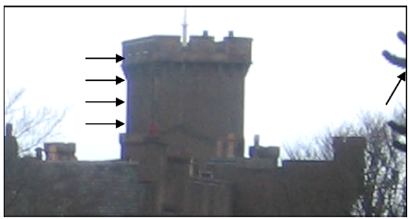
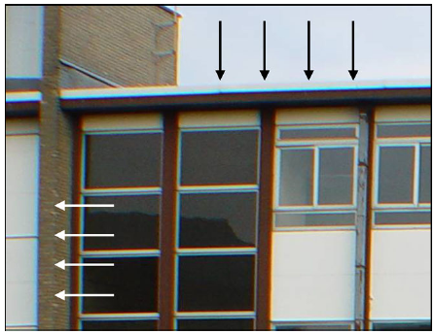
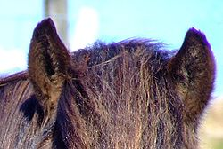
PFA Examples

Slide 12
Algorithm
Identify PFA edges
Determine PFA direction for each event
Assign reliability measure to each event
Determine the image center
Reevaluate directions to detect the inconsistent regions

Slide 13
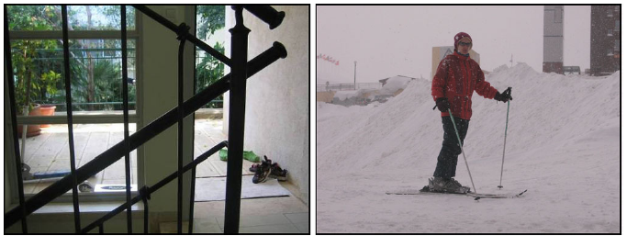
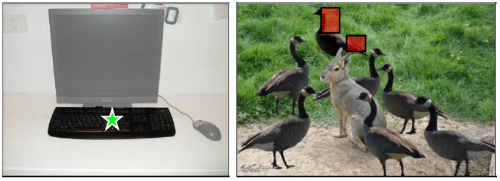

Slide 15
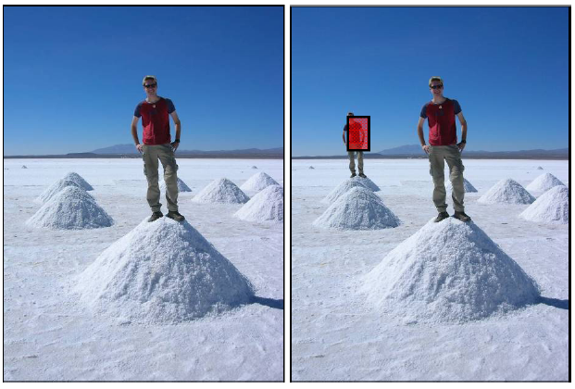

Slide 16
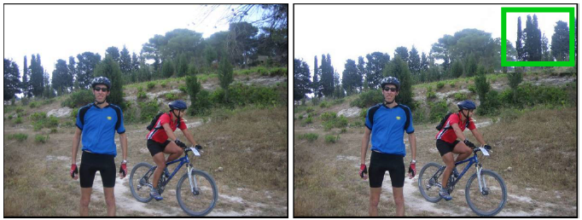

Slide 17
References
Daly, D. (2001). Microlenses arrays. Boca Raton CRC press.
Fridrich, J., Soukal, D., & Lukas, J. (2003). Detection of copy-move forgery in digital images. In Proc. Digital forensic research workshop, Cleveland, OH.
Johnson, M. K. & Farid, H. (2006) Exposing digital forgeries through chromatic aberration. On Proc. ACM multimedia and security workshop, Geneva, Switzerland.
Ochi, S., Lizuka, T., Sato, Y., Hamasaki, M., Abe, H., Narabu, T., Kato, K., & Kagawa, Y. (1997). Charge-coupled device technology. Boca Raton : CRC press.
Rudolf, K. (1992). Optics in photography. Bellingham: SIPE.
Yerushalmy&Hel-Or (2010) Digital Image Forgery Detection Based on Lens and Sensor Aberration, International Journal of Computer Vision
Wang, W., & Farid, H. (2006). Exposing digital forgeries in video by detecting double MPEG compression. In Proc. ACM multimedia and security workshop, Geneva, Switzerland.
Wolfgang, R. B., & Delp, E. J., (1996). A watermark for digital images. In Proc. IEEE intl conference on image processing.
Wikipedia.org (http://www.wikipedia.org)

Slide 18
Thank you Q ?

